Slide 1
Who is the Monster?
The subjectivity of good and evil
Haegang Yang

Slide 2


Slide 3
1. Cho is a monster

Slide 4

Murder cannot be accepted

Slide 5

Bullied people also have problems

Slide 6
2. Bully is a monster

Slide 7

Affect of bully in childhood

Slide 8

Racism and mental health problem

Slide 9
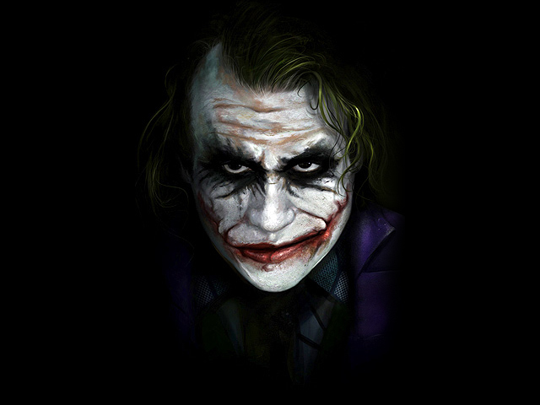

Slide 10
Thank you

